Slide 1
COM343 Object Oriented Programming
Object Oriented Analysis and Design

Slide 2
Software Methodologies
A development methodology is a set of practices or guidelines used to develop software
E.g. Rational Unified Process, Extreme Programming (XP)
UML is not a software development methodology, it is a notation
All methodologies somehow include below parts
Plan : analysis, design
Build : code, debug, unit test
Release : integration test, learn, maintain
Before OOP, these steps were commonly taken as a strict sequence: waterfall development
Today, it is often taken as subsequent iterations of these steps (agile development)

Slide 3
Elements of a Software Project
Customer contacts software developer to discuss creating a new software system
Customer and developer may be from same company
Customer meets with the developer and provides a description of the system.
This description is from customer’s and problem domain’s perspective
Together, they form a more detailed initial specification
Developer can use this to determine the feasibility and cost estimation for the project

Slide 4
Elements of a Software Project
Planning almost always consists of two stages, analysis and design
In OO, a major goal in planning stage is to discover
what objects the system will need, and
what the responsibilities of objects are, and
how they will interact with each other
In analysis, objects are considered at a higher level than in design
The size of the project often determines how distinct planning, building, and release phases are
XP is suitable for small to medium sized projects. The three phases can be difficult to separate
In a larger project, distinction will be more apparent

Slide 5
UML – Use Cases
Used to understand interactions between users and parts of the system
Made up of scenarios, which are a(n example) sequence of steps describing an interaction
Users are called actors
Consider the example on the next page
a reader borrowing a book from a library
Reader will usually interact with a Librarian

Slide 6
Use Case Example
Reader finds a Book to Borrow, hands it to Librarian
Librarian identifies the Reader in Library system
Librarian identifies the Book in Library system
Librarian lends the Book to the Reader with Library system
Borrowing is registered in Library system
This is only one scenario.
There will be others
Reader cannot find the book
Book might not be allowed to leave the library
etc.
Each possibility should be examined in alternative scenarios
Together, scenarios make up one use case

Slide 7
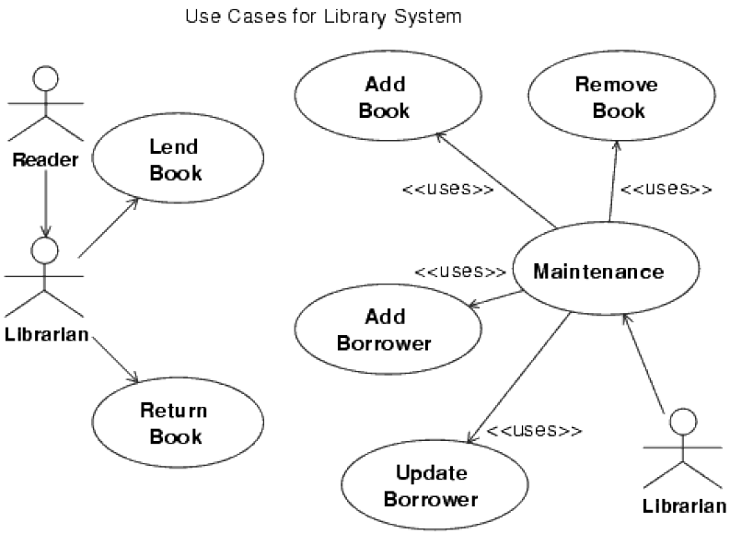
Use Case Example
The goal is to identify actors, objects, and interactions between them
Actors don’t need to be people
They can be other objects in the system, other systems, etc.
Stick figures represent actors
Ovals represent use cases

Slide 8
The Essence of OOA
Should involve both the development team and the customer
Customer knows the problem domain and what the system needs to do
Development team knows how to use programming and software resources to design a system that meets the customer’s requirements
There can be different techniques, steps, or strategies used for OOA depending on the specific methodology used
Here, we cover major aspects of OOA

Slide 9
Object Discovery
The goal is to find objects that can potentially become part of the system
Examine system specifications
Even the smallest project should have some kind of written specification
Use Cases and CRC Cards (will be explained shortly) can help in discovery
Initially, try to find as many candidate objects as possible
Customer may not know
anything about objects
exactly what they want or need
Specification is likely to be inaccurate or incomplete
It is common to find flaws in customer’s specification, therefore it is important to work closely with the customer

Slide 10
Object Discovery
To start with, use textual description to pick out nouns and verbs
Nouns represent candidate objects
Verbs represent candidate operations or methods
Producing a definitive candidate list of objects is not trivial
2 analysts or designers can come up with different lists
Picking from nouns and verbs is a starter
Once a few objects are identified, additional candidates can be found by going over the specification

Slide 11
Object Discovery
Looking for the following things can help discover objects
Problem space itself, together with any diagrams, pictures, and textual information provided by the customer
Other systems that communicate or interact with the system being modeled
Physical devices that will exist in the environment and interact with the system
Events that must be recorded and remembered
Roles played by different people who interact with the system
Physical or geographical locations and sites that may be relevant to the system
Organizational units (departments, divisions, etc.) that may be relevant to the system

Slide 12
Object Discovery
As you go through the previous list, you will discover candidate attributes as well as candidate objects
Early on, it may not be clear if something should be an object or an attribute (perfectly normal)
Once you have a list of candidate objects, it’s time to think about responsibilities
What function does an object perform?
What are its responsibilities to the rest of the system?
Concentrating on verbs in problem statement can help
So can CRC Cards

Slide 13
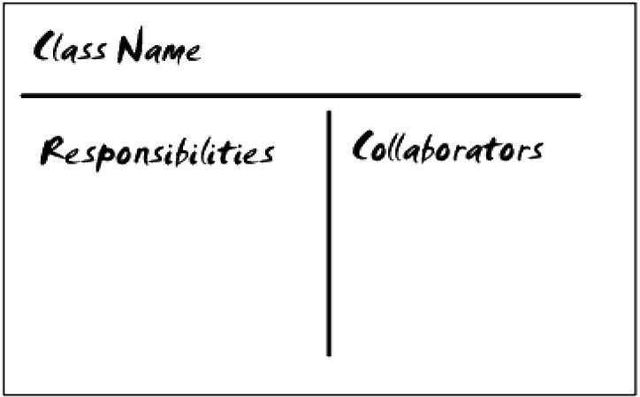
CRC Cards
Class-Responsibility-Collaborator Cards (not part of UML)
A single card for each class stating
its name
its responsibilities, and
other classes that need to collaborate with it
Often used in interactive discussion sessions and to generate UML diagrams
Cards are role played in these sessions according to scenarios (from Use Cases)
Often, need for new classes or different responsibilities is discovered

Slide 14
Evaluate Candidate Objects
Once you have a list of candidate objects, you move on to their evaluation
Generally, there are too many objects. You should,
remember inheritance and look for the possibility to generalize some objects into a higher level class
be careful not to use inheritance when aggregation or composition is more appropriate (is-a vs. has-a relationship)
ask yourself if all objects are necessary

Slide 15
Evaluate Candidate Objects
Consider the following points
Each object should have some data. You may not know all attributes yet, but you can make sure each object requires at least some attributes
When an object has a single attribute, maybe it is better to make it an attribute of another object
It is possible to have a single or no attribute object, but this may indicate a closer look is needed
Similarly, each object should do something, i.e., should have one or more methods
You will encounter objects without any methods very very rarely
Function and purpose of an object should be independent of the existing hardware or software
If it is not, it is an implementation object rather than an essential object for the overall system. Such objects should be considered later, not early on during design
All attributes should apply to all objects from that class
If not, there may be a hierarchy not implemented
Similarly to the previous one, all methods should apply to all objects from that class
Techniques used in Refactoring (later Chp. 8) can be useful

Slide 16
Determine Object Hierarchies
Object discovery and detecting hierarchies sometimes overlap
For some objects, hierarchy will be obvious and it will be detected as soon as you discover the objects
For others, it can be less obvious
Remember
Generalization / specialization, inheritance, is-a relationship
Often more natural
Easy to discover during object discovery
Whole / part, aggregation or composition, has-a relationship
Sometimes obvious but sometimes you have to look for it explicitly.
Often discovered after the initial object discovery
Not everything has to fit into a single hierarchy

Slide 17
Discover Object Attributes
An object’s attributes describe its meaning
At the design level, attributes can be
public (available to the world)
private (internal use only)
Note: These are not the same as public/private keywords you use in implementation
In OOA, you are concerned with public ones
Ask questions such as:
What describes an object X?
How is it described in the problem domain?
What does it need to know to carry out its function?
What state info it needs to remember over time?
What states can it be in?
As you identify attributes, place them as high as possible in the hierarchy
Attribute discovery may force you to change your hierarchy

Slide 18
Discover Object Operations
Similar to the attributes, a class will have private and public methods and in analysis stage concentration is on public ones
There are several kinds of methods
Methods that respond to messages may be the most obvious
Setter and getter methods are often just implicitly assumed for each public attribute
Relationships are established between classes and objects during A & D.
Classes need to provide methods to build these connections
UML sequence diagrams (next) are useful in understanding relationships among objects

Slide 19
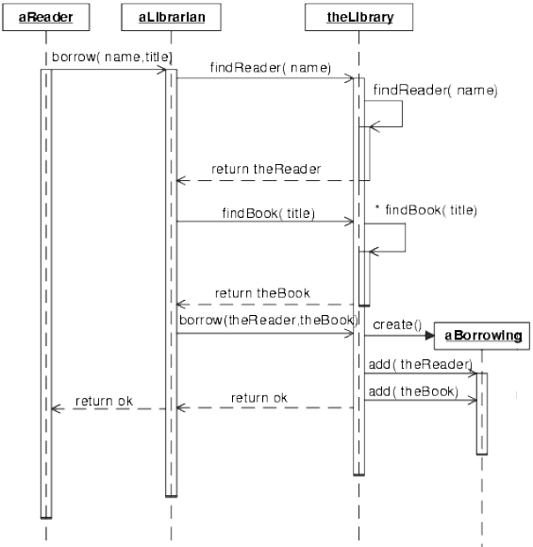
UML Sequence Diagrams
Useful to understand how objects will interact with each other
Example object instances are shown horizontally with lifetimes that stretch vertically
Time goes from top to bottom
Used together with use cases
Each scenario shown in a sequence diagram

Slide 20
The Essence of OOD
OOD takes results of OOA and produces a detailed design suitable for implementation
As we said before, in small projects, analysis and design (and even design and implementation) can be difficult to draw lines in between
A main difference is that OOD considers more detail
Refine candidate objects from OOA into real classes with defined operations and attributes (data structures to be used, etc.)
Notes:
Use shape-circle-rectangle example to explain different levels of detail

Slide 21
Some Design Guidelines
Get the big picture
Understand what the software needs to do and what resources it will require
Understand the problem
Understand the target environment
Think objects
Get help
Encapsulation
Objects encapsulate attributes and behavior, and this makes software more robust, easier to debug, easier to modify, and easier to maintain
Maximize encapsulation: the more independent each class is, the better
Minimize coupling: classes should not rely on knowing anything about how the other class works internally
Separate the GUI: it should be possible to completely replace the GUI without affecting the rest (MVC design pattern – later)

Slide 22
Some Design Guidelines
Designing Classes
A class needs a purpose
Classes vs. attributes
Note: because Java doesn’t have structures, sometimes it may be OK to have classes which do not have operations, but not frequently
Associations vs. inheritance
E.g. Circle – Shape – Drawing
A class can’t do everything
Inheritance
Is-A Test: All classes in an inheritance must pass the is-a test
Is-a test may not always be enough: names can mislead
E.g. room is a rectangular volume
Move attributes and methods as high as possible
But do not exaggerate this
Find superclasses

Slide 23
Some Design Guidelines
General Guidelines (again and again)
Names matter
One thing at a time
Don’t reinvent the wheel
You won’t get it right the first time
Refactoring
Simplicity
Occam’s razor
Your software won’t go away
Remember remember the 31st of December (1999)

Slide 24
The Build and Release Phases - Building the Software
It may be tempting to dive into coding straightaway, but planning will lead to better software
3 major activities
Writing code
Testing (pieces, i.e. unit testing)
Debugging
One recent trend is the emphasis on incremental testing and integration
Traditional tendency was to develop fairly large pieces (with minimal testing) and then to integrate them
It is now thought much better to get small parts working, perform unit tests, and to frequently integrate parts

Slide 25
Code Reviews and Ownership
In a code review, a group of programmers goes over a piece of code line by line
Usually, the author of the code is part of the review to help explain what code does
People tend to overlook mistakes in their own code
Code reviews help spread expert knowledge
No room for being harsh or judgemental
Code reviews also promote joint-ownership

Slide 26
Releasing the Software
Traditionally, a finished software is handed over to a testing team (separate from the development team) for final testing (functional testing)
When a project is released, it enters maintenance phase
Often this means handing the finished code over to a maintenance team (traditionally, the newest, least experienced programmers)
There should be close contact with the development team as long as possible
In reality, development team won’t be around after at most a few years

Slide 27
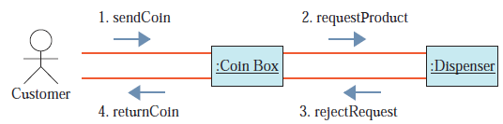
More UML Diagrams
Collaboration Diagrams
Also shows object interactions as Sequence Diagrams
Sequence diagrams show dynamic interactions whereas Collaboration diagrams show static relationships and messages
Consist of
Objects,
Classes they belong to,
Links and messages with sequence numbers

Slide 28
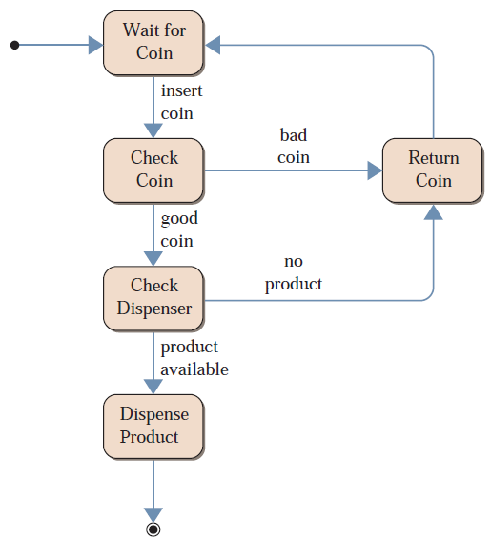
More UML Diagrams
State Diagrams
Used when an object has well-defined states
Serves as a complement to the class description
Shows all possible states that objects of the class can have
And which events cause the state to change

Slide 29
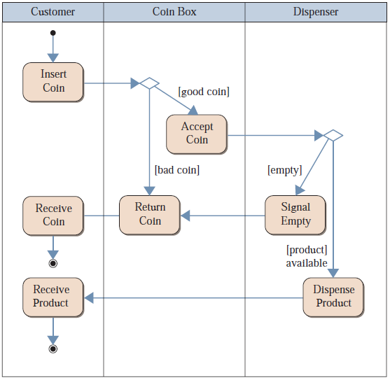
More UML Diagrams
Activity Diagrams
Used to show flow of activities
Focus on high level view of an entire process
They can help understand what is happening in a use case
Useful for showing workflow and in describing behavior of the system with parallel processing

Slide 30
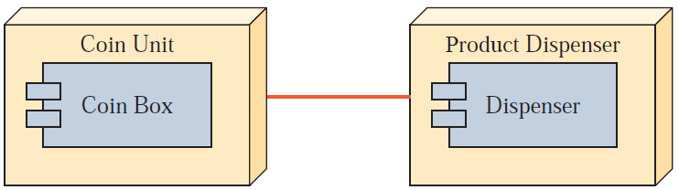
More UML Diagrams
Deployment Diagrams
Used to represent physical relationships among software and hardware components in a system
Can show how components and objects move around a networked system

Slide 31
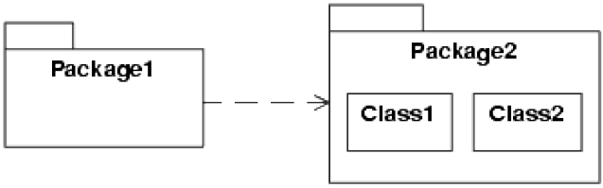
More UML Diagrams
Package
UML Package symbol is used to group various UML items together
Classes, use cases, collaborations, etc. can be grouped together
Then relationships between various packages can be shown.

